Slide 1
CSE623 Machine Learning Theory and Practice TheOverFitters
Modelling and Prediction of Athlete Readiness based on Sleep and Recovery Patterns
Rahil Patel AU2240211
Yash Smart AU2240076
Prem Patel AU2240010
Aryan Sukhadia AU2240069
Naitik Shah AU2240047
Btech. CSE, School of Engineering and Applied Sciences
Btech. CSE, School of Engineering and Applied Sciences
Btech. CSE, School of Engineering and Applied Sciences
Btech. CSE, School of Engineering and Applied Sciences
Btech. CSE, School of Engineering and Applied Sciences

Slide 2
Content
Introduction
Problem Statement
Literature Survey
Dataset Discussion
Approach, Results & Future Work
References

Slide 3
Introduction
Athletic performance is influenced by sleep, training, fatigue, and recovery.
This project predicts athletic readiness using sleep and recovery patterns.
Factors include travel, training, academics, and social commitments.
Previous studies used RSI to predict game performance and readiness but it often lacks accuracy in predicting true readiness, especially when external factors like sleep and academic stress are involved.
Insights help athletes and coaches optimize recovery and enhance performance.

Slide 4
Problem Statement
The objective of this project is to assess the impact of athlete sleep patterns on their performance (readiness) and thereby predict RSImod (Reactive Strength Index Modified). RSImod is a readiness measure used in sports science to assess an athlete’s neuromuscular fatigue.
Athletic Readiness & Challenges
Crucial for performance & injury prevention.
Traditional assessments(RSI) lack accuracy in predicting readiness.
Collegiate basketball players experience fatigue due to:
Frequent games & travel.
Academic stress affecting sleep & recovery.

Slide 5
Literature Survey
Study Title | Authors | Year | Methodology | Main Findings
Impact of Sleep and Training on Game Performance and Injury in Division-1 Women’s Basketball Amidst the Pandemic [1] | S Senbel et al. | 2022 | Collect sleep data of athletes using sleep monitoring devices, training data from coaches, injury reports from medical staff, and weekly survey data from athletes for 22 weeks. Predict game performance and injuries using machine learning algorithms. | Game performance and injuries can be predicted with more than 90% accuracy. The F1 and F2 scores of 0.94 and 0.83 for game performance and injuries, respectively, show that one can use the prediction for informative analysis in the future for coaches to make insightful decisions.
A holistic approach to performance prediction in collegiate athletics: player, team, and conference perspectives [2] | T Kaya et al. | 2024 | Monitor players and collect data. The data includes parameters from training, subjective stress, sleep and recovery, in-game statistics, and countermovement jumps. Predict RSI (reactive strength index) and GS(Game Score) using machine learning algorithms. | Achieved 90% accuracy and 0.9 F1 score in predicting RSI and GS by using data balancing techniques and an Extreme Gradient Boosting (XGB) classifier score. The XGB regressor predicted player efficiency rating with an MSE of 0.026 and an R² of 0.680.
A Hybrid Approach for Interpretable Game Performance Prediction in Basketball [3] | SU Sharma et al. | 2022 | Perform factor analysis to compactly characterize the athlete’s data in terms of 7 latent factors. Use these factors to build a collection of decision trees for predicting and interpreting the game score. | Achieved an MSE of 0.013 and an R² score of 0.971.

Slide 6
Dataset Discussion
The dataset contains 3,111 records with 28 attributes related to athlete health and performance.
The dataset contains biometric data of athletes which includes resting heart rate (RHR), heart rate variability (HRV), sleep quality, recovery metrics, respiratory rate and reactive strength index (RSI).
Data is recorded for 17 athletes.
The data for all the athletes was recorded daily from 6 September 2021 to 7 March 2022, spanning approximately six months.
There were some missing values in the dataset, which required data preprocessing.

Slide 7
Dataset Discussion
Column | Null Value Count
Athlete | 0
Date | 0
Day.of.Week | 1124
RHR | 1130
HRV | 1130
Recovery | 1130
Sleep.Score | 1130
Hours.in.Bed | 1130
Hours.of.Sleep | 1130
Sleep.Need | 1130
Sleep.Efficiency.... | 1130
Wake.Periods | 1490
Sleep.Disturbances | 1130
Latency..min. | 1130
Column | Null Value Count
Cycles | 1130
REM.Sleep..hours. | 1130
Deep.Sleep..hours. | 1130
Light.Sleep..hours. | 1130
Awake..hours. | 1130
Sleep.Debt..hours. | 1130
Sleep.Consistency | 1401
Respiratory.Rate | 1134
Total.Cycle.Sleep.Time..hours. | 1130
REM.Percentage | 1130
Deep.Sleep.Percentage | 1130
Restorative.Sleep..hours. | 1490
Restorative.Sleep.... | 1130
RSI | 2925

Slide 8
Approach (1/2)
Used Iterative Imputer(MICE) with XGBoost as model to replace the missing values in the data. Scaled the data with standard scaler.
Used Recursive Feature Elimination(RFE) with XGBoost as model to remove columns with less importance. Selected top 18 columns for further training.
Splitted the data into two parts. One for training (80%) and the other for testing (20%).

Slide 9
Approach (2/2)
Trained three models: linear regression, random forest regression, and XGBoost Regressor.
Evaluated the performance of the three models using Mean Squared Error(MSE), Mean Absolute Error(MAE) and R² score. Out of the three models XGBoost regression performed the best with R² score of 0.91.
Performed a SHAP analysis to analyze the importance of features in the XGBoost Regressor model. Choose the top 12 features based on their importance and retrained the model to get the same R² score of 0.91.

Slide 10
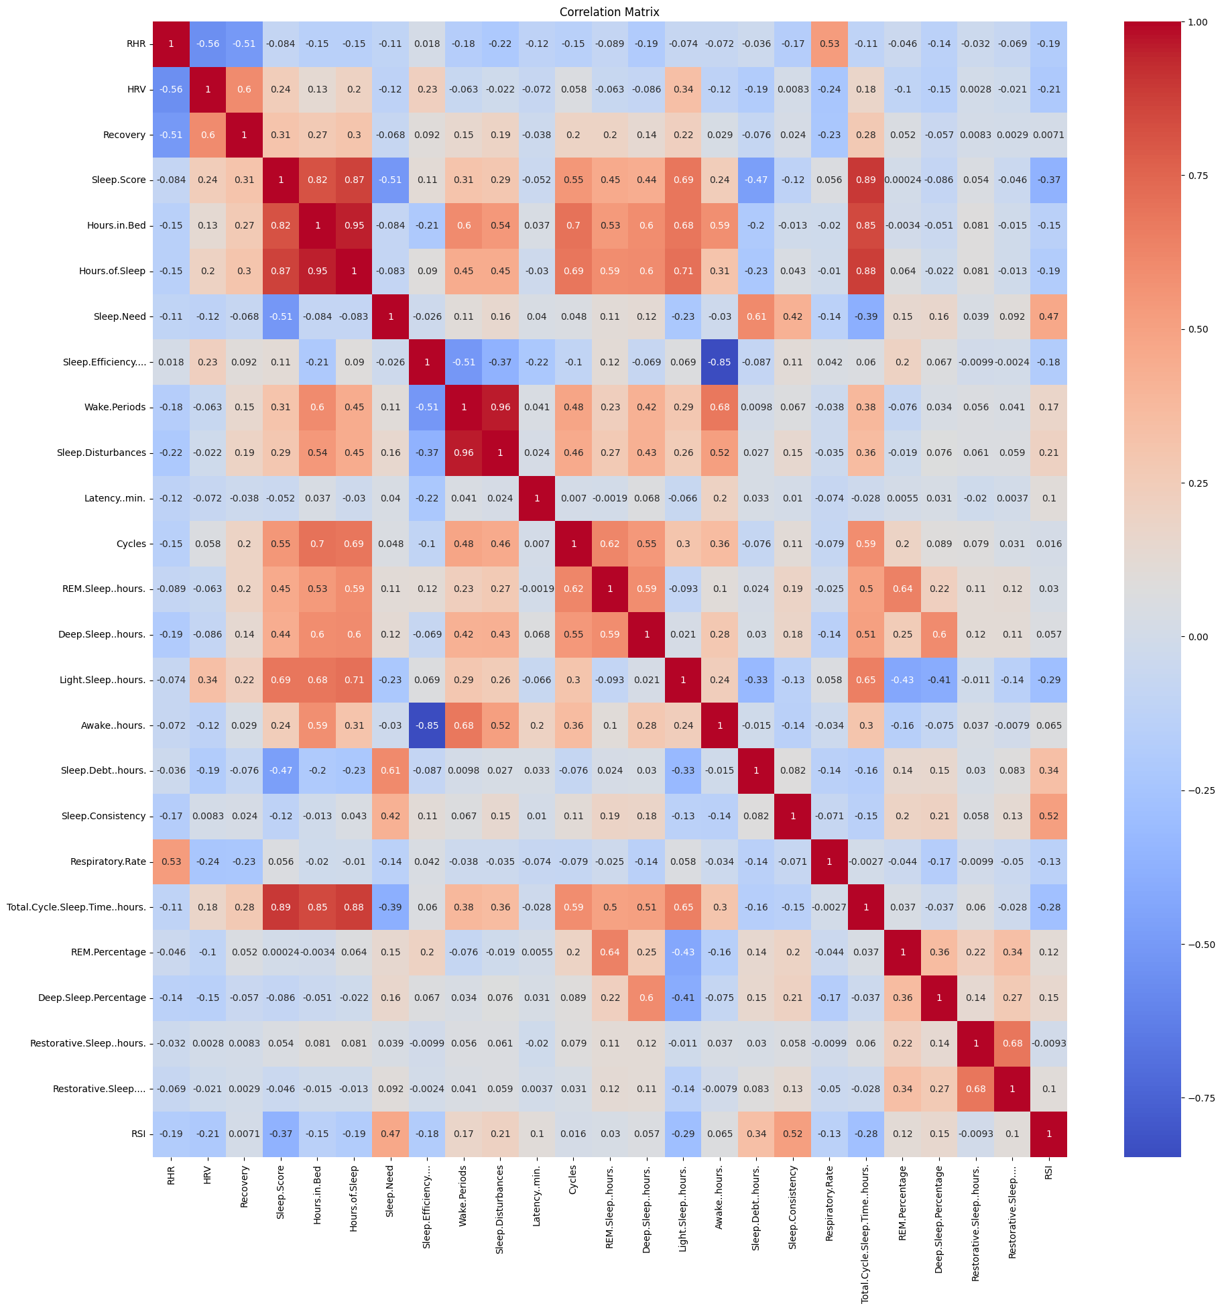
Results
Initial Correlation Matrix

Slide 11
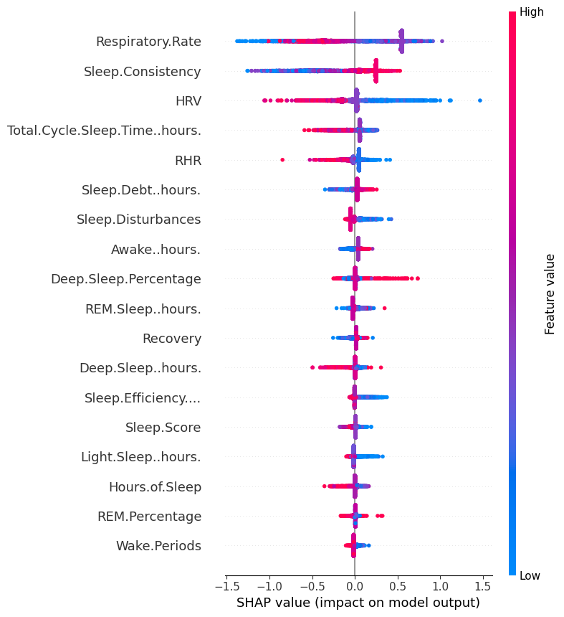
Results
Shap values

Slide 12
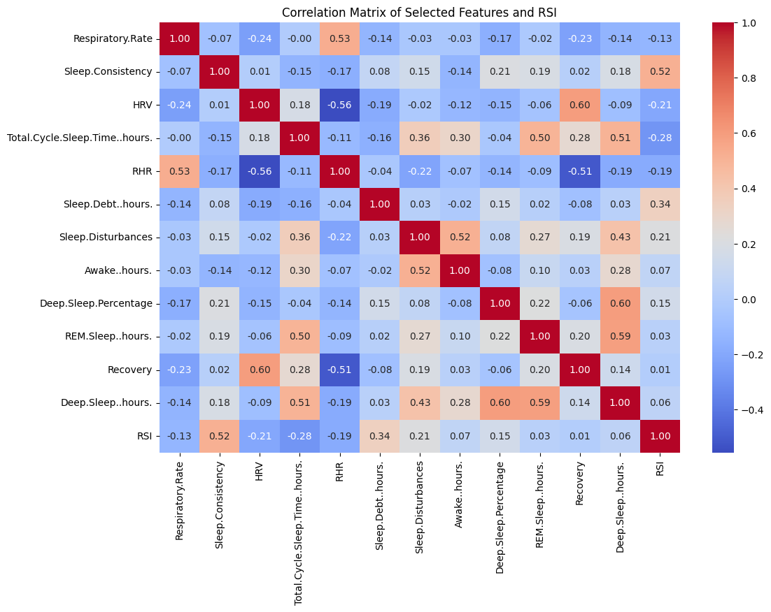
Results
Final Correlation Matrix After Feature reduction

Slide 13
Future Work
Use xAI techniques to understand the behavior of the model(XGBoost regressor in this case).
Permutation importance is one such xAI technique which helps evaluate the importance of particular feature by computing the drop/gain in RSImod prediction performance metric(R² score), if the values in that column is randomly shuffled.
LIME (Local Interpretable Model-agnostic Explanations) is another such xAI technique which helps analyzing how increase and decrease of a particular feature affects the RSImod.
Report findings using Generic based approach.

Slide 14
References
Senbel, S., Sharma, S., Raval, M. S., Taber, C., Nolan, J., Artan, N. S., ... & Kaya, T. (2022). Impact of sleep and training on game performance and injury in division-1 women’s Basketball Amidst the Pandemic. Ieee Access, 10, 15516-15527. https://ieeexplore.ieee.org/abstract/document/9690164/
Taber, C.B., Sharma, S., Raval, M.S. et al. A holistic approach to performance prediction in collegiate athletics: player, team, and conference perspectives. Sci Rep 14, 1162 (2024). https://doi.org/10.1038/s41598-024-51658-8
Sharma, S. U., Divakaran, S., Kaya, T., & Raval, M. (2022, July). A Hybrid Approach for Interpretable Game Performance Prediction in Basketball. In 2022 International Joint Conference on Neural Networks (IJCNN) (pp. 01-08). IEEE. https://ieeexplore.ieee.org/abstract/document/9892583/?casa_token=Ye3GQJ1JpD0AAAAA:GSlyds24pIa__7Od6UBSNs8nugbEwLvCbI8vG6w-YMYrFX2O-TUlUDo4xej3ulJUAvmO_4ij0J36

Slide 15
Thank You

